Slide 1

Final project
Mary Cris Macellones – C0768027

Slide 2
Safe Calculator
Brief Description
As an International Student I also do part time in Shoppers Drugmart as a Cash Supervisor. In every shift, it is required for us to count the safe 4x every day and sometimes become tedious, that’s why I came up with this idea as project. Its not just will help me pass the subject but will also help me during my shift in my part time job. Its like hitting two birds with one stone.
We count the safe by rolls of coins, so for nickel a roll is equal to two dollars, dime is five dollars, quarter is ten dollars, looney is twenty-five, tooney is fifty and then for bills is per piece. In the mobile app you have to enter the number of pieces of rolls for coins and pieces of bills to get the total.

Slide 3
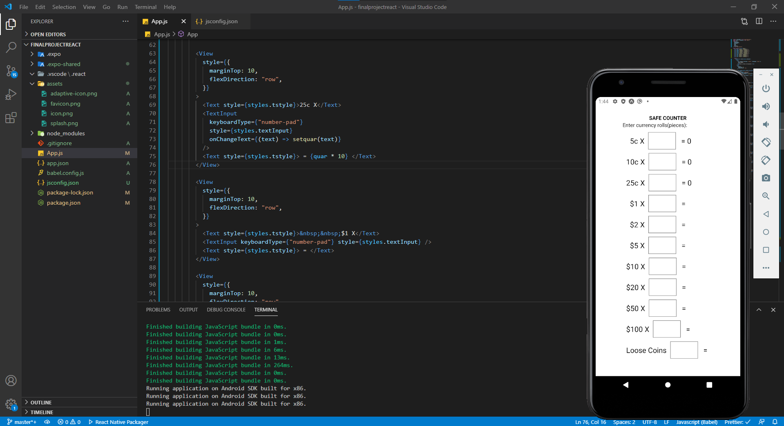

Slide 4
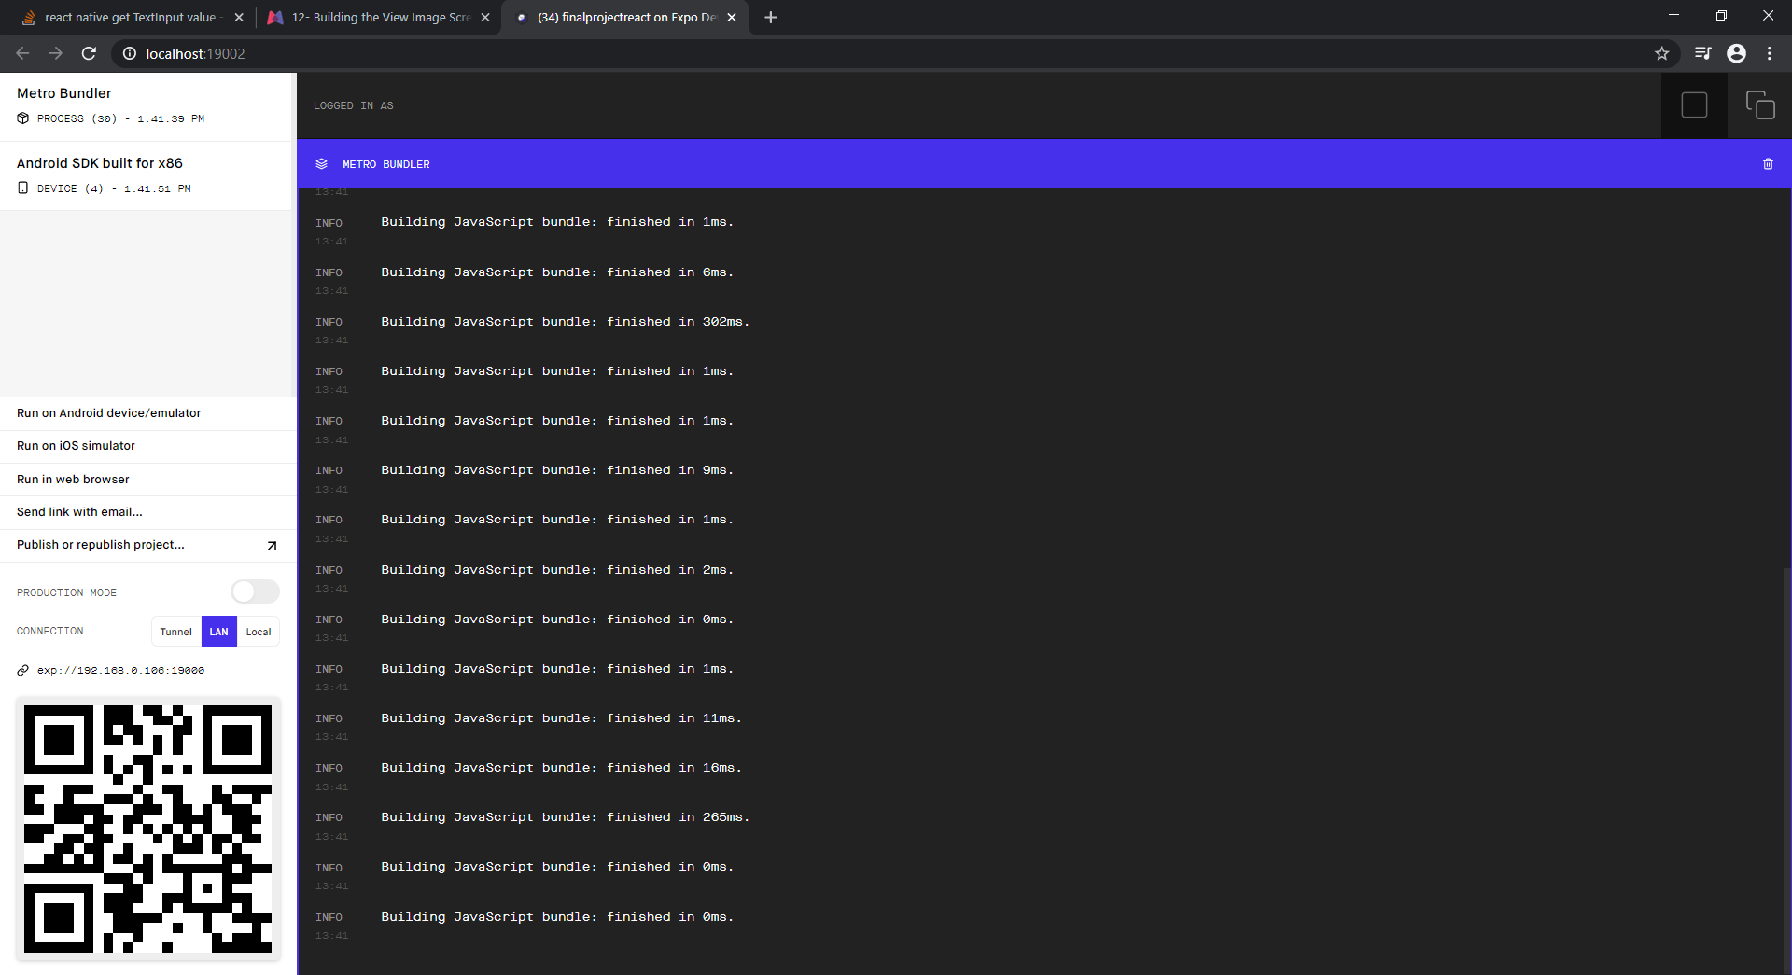

Slide 5
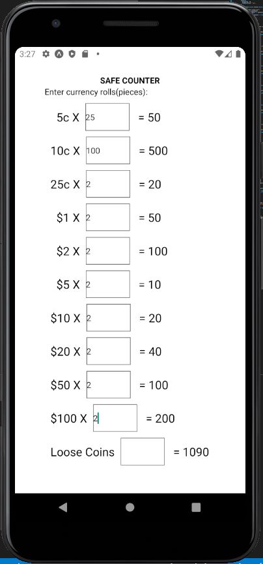

Slide 6
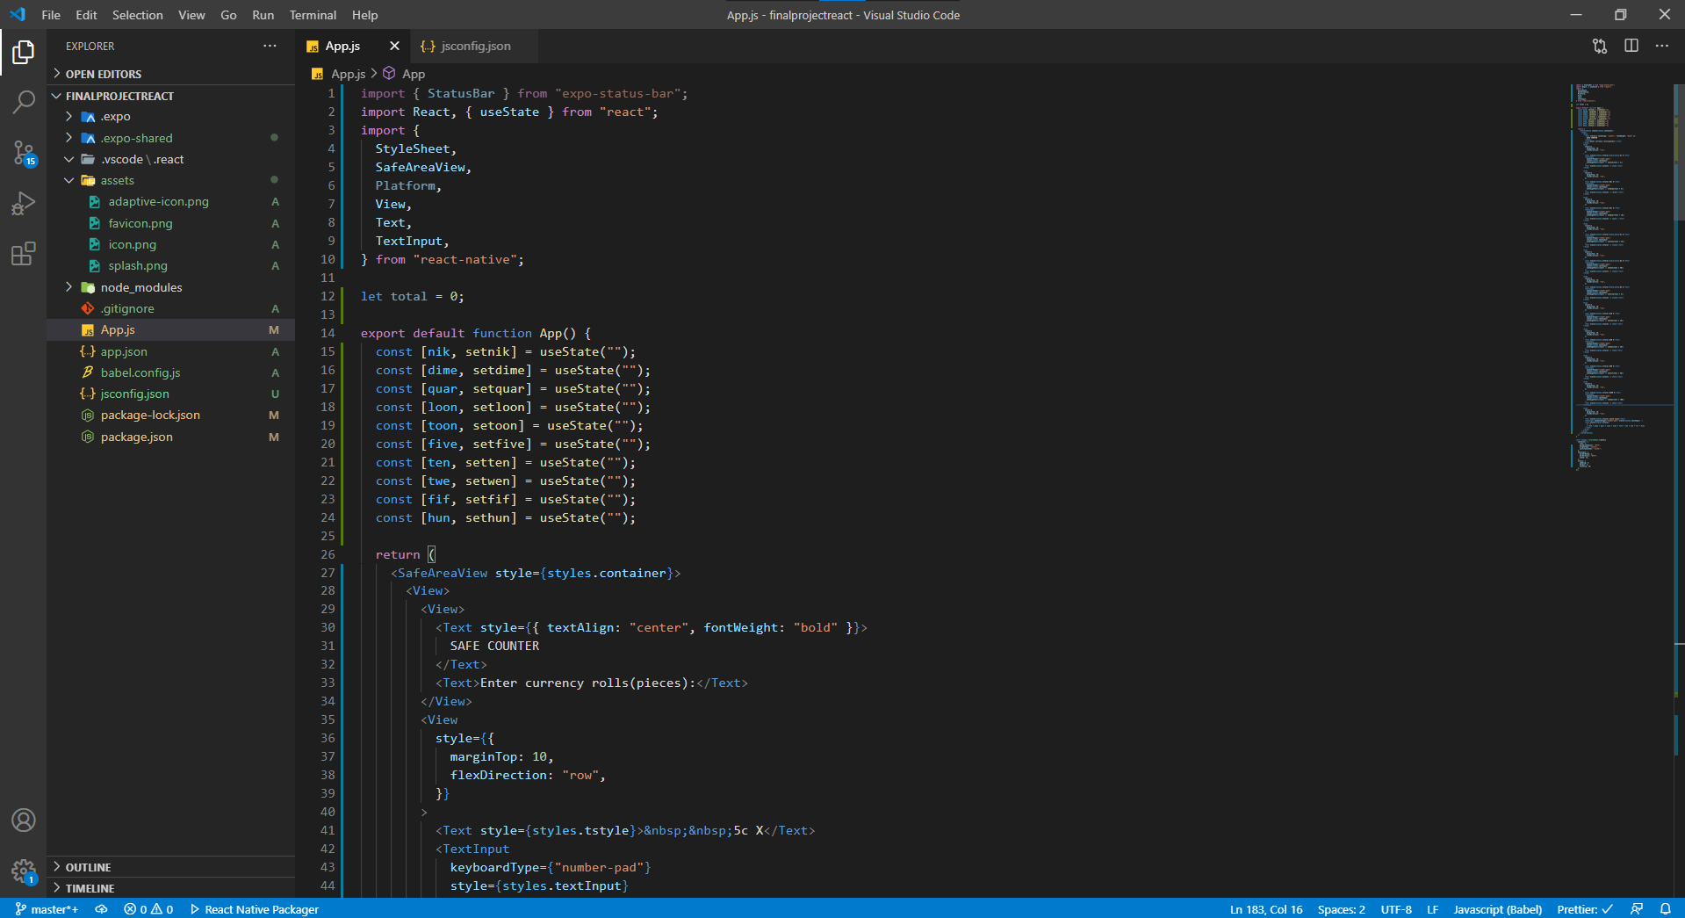

Slide 7
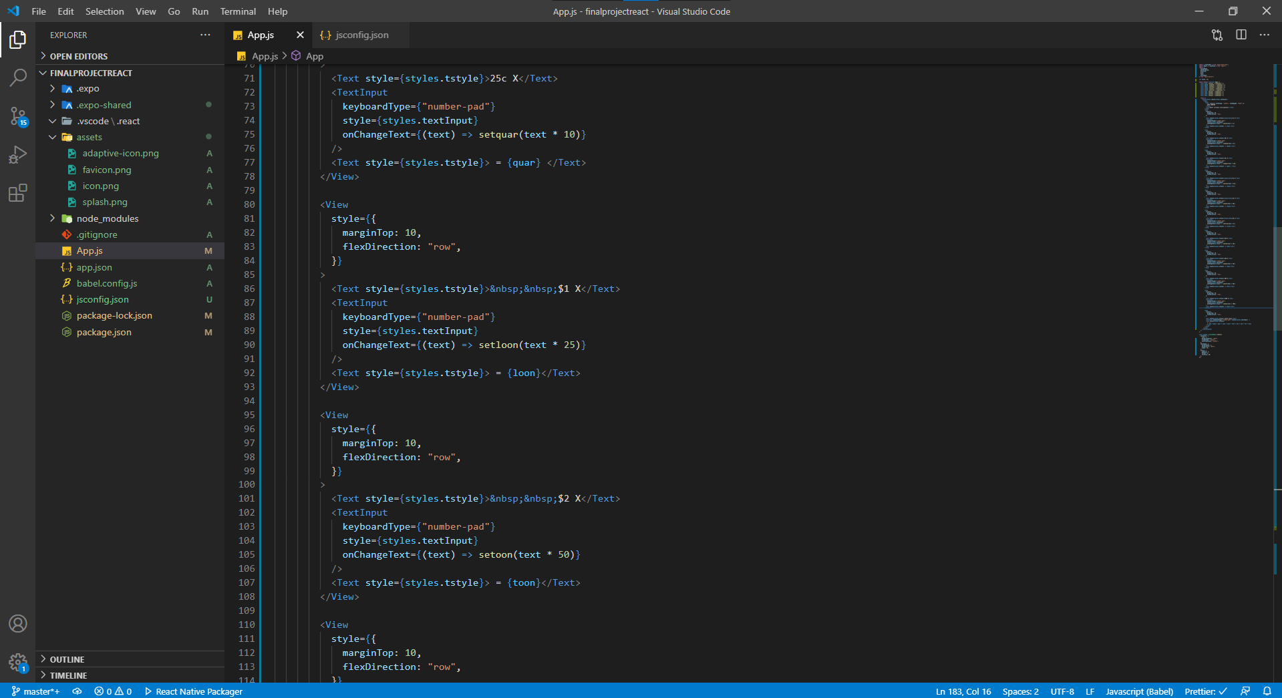

Slide 8
